Slide 1
Sales Performance Overview

Slide 2
Key Objective
To Provide an overview of sales performance and Identify key growth opportunities.

Slide 3
Key Points
Sales Revenue Trends
Online vs Offline Orders
Top Products by revenue
Sales by Region

Slide 4
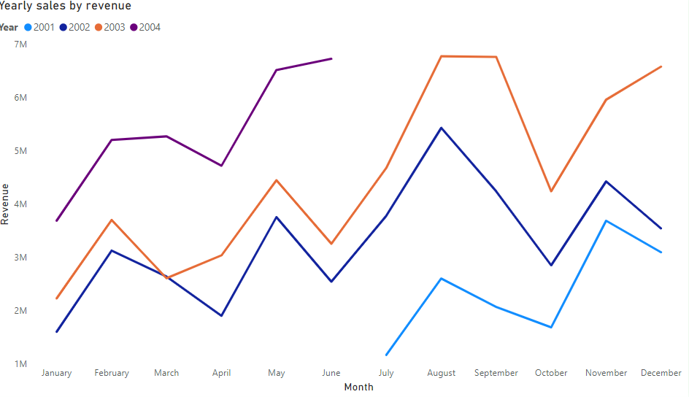
Sales Revenue Trends: 2001-2004
The chart reveals an overall upward trend in sales revenue over the years.
August and November consistently show significant increases in sales across all years.

Slide 5
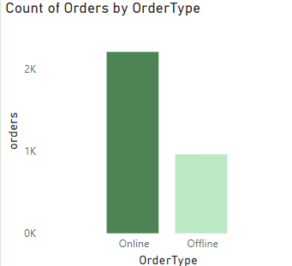
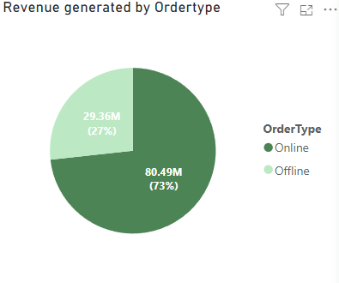
Offline VS Online sales revenue trend
Online orders contributed a significantly higher percentage of total revenue (73%), indicating a strong customer preference for digital purchasing channels. This also suggests a shift in buying behavior towards convenience and accessibility provided by online platforms.

Slide 6
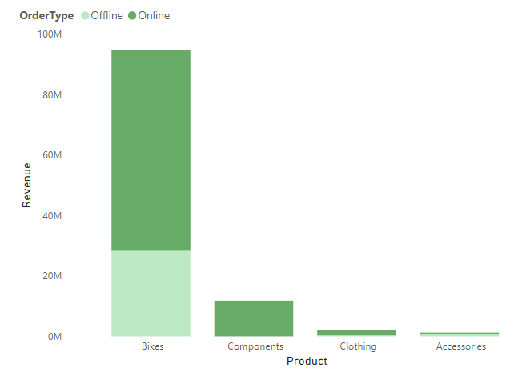
Top Products by revenue
The revenue from bikes significantly outpaces that from other product categories (Components, Clothing, and Accessories).
Generally, most products are being ordered online than offline.

Slide 7
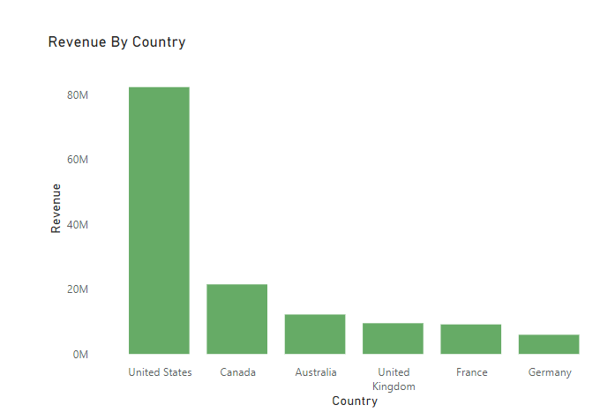
Geographic Sales Patterns
There is a strong concetration in revenue generation in United States than any other country

Slide 8
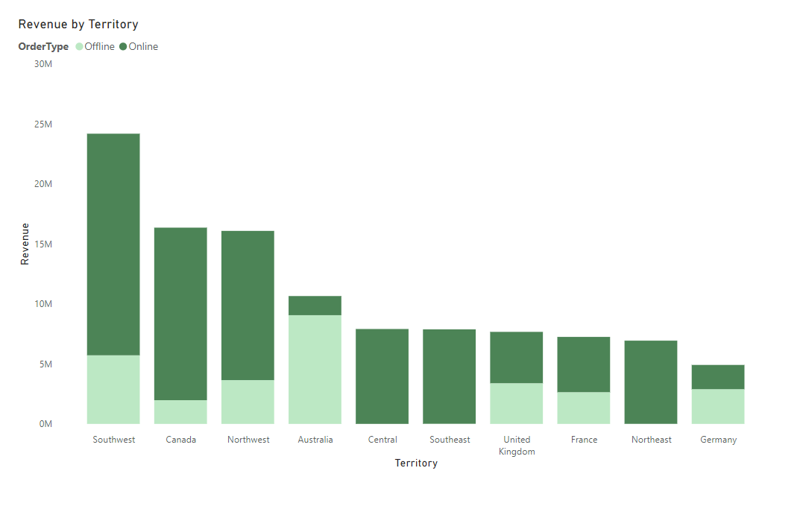
Geographic Sales Patterns
The Southwest territory leads by a large margin, especially in offline orders.
Canada and Northwest are the next strongest contributors with a similar online-heavy split.
Australia stands out for having a higher share of offline revenue.

Slide 9
1. Focus on developing customized marketing strategies for underperforming regions, while scaling successful strategies in high-performing regions. Consider adjusting inventory distribution to better support regional demand. 2. Prioritize marketing efforts for high-revenue products and consider expanding product lines or bundles for the best-sellers. Identify underperforming products for potential phase-out or rebranding. 3. Focus on developing customized marketing strategies for underperforming regions, while scaling successful strategies in high-performing regions. Consider adjusting inventory distribution to better support regional demand.
Recommendations

Slide 10
By Focusing On These Insights And Acting On The Recommendations, We Can Drive Sustainable Growth And Strengthen Our Competitive Advantage

Slide 11
Questions?

